Slide 1
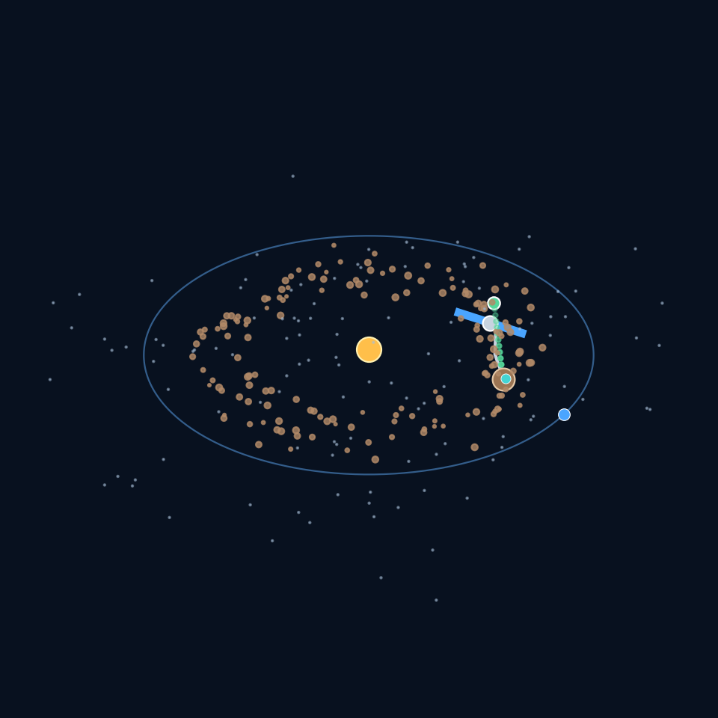
ASTRA | Mining Beyond Earth
A 3D concept model of asteroid-belt prospecting, autonomous mining, and resource use in space
THE PROBLEM
Earth-launched missions are expensive. How can we find useful asteroid resources and process them in space instead of hauling everything home?
3D CONCEPT SCENE
Scale and positions are illustrative, not navigation data.

Slide 2
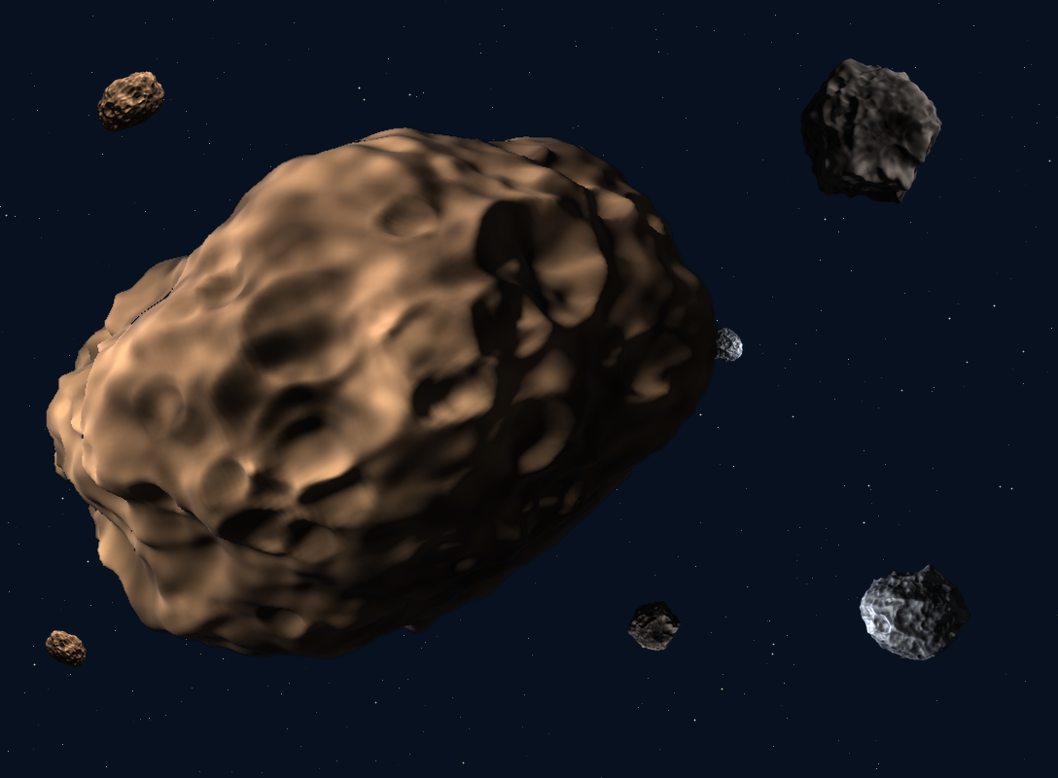
01 | The problem to solve
A credible concept must show where the belt is, what is mined, and how the material is used.
• Asteroids are far away; missions need careful navigation and communication.
• Each target differs in shape, spin, surface strength, and composition.
• Landing, anchoring, drilling, and collecting loose material are difficult in microgravity.
• Launching all supplies from Earth is costly—so prioritize resources that can be used in space.

Slide 3
02 | Where is the asteroid belt?
The main belt lies mostly between Mars and Jupiter; this diagram is a simplified, not-to-scale layout.
SUN
Energy source
EARTH
Mission assembly, control, and launch
ASTEROID BELT
Candidate targets are surveyed before selecting one
KEY IDEA
Do not treat the belt as a dense wall of rocks. Objects are separated by vast distances.

Slide 4
03 | The mining spacecraft
Subsystems shown in the downloadable 3D model: power, sensing, robotics, and communications.
1. Solar arrays — supply electrical power.
2. Sensor head — cameras, lidar, and spectrometers map the asteroid.
3. AI navigation — helps estimate pose, choose safe approach paths, and detect hazards.
4. Robotic arm + drill — anchor, sample, and excavate cautiously.
5. Antenna — links spacecraft with mission control.

Slide 5
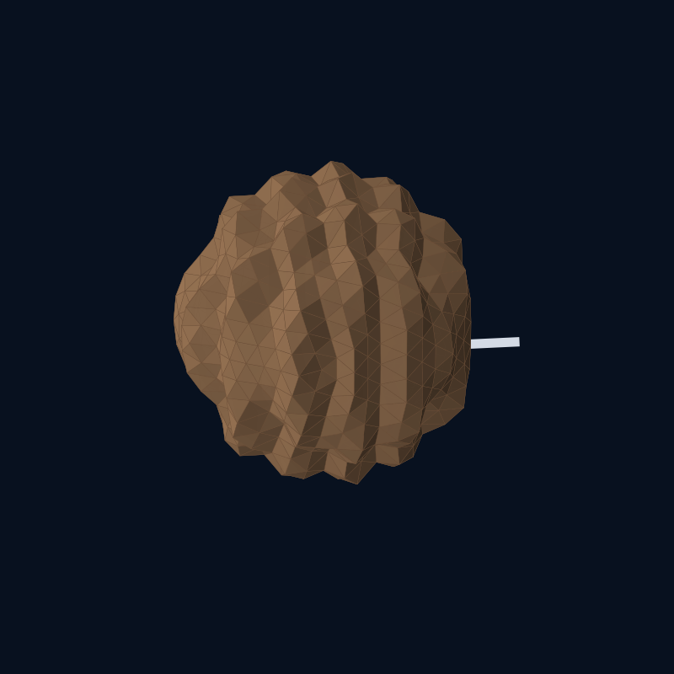
04 | What is being mined?
A rough asteroid with a highlighted illustrative resource zone; real composition must be measured.
SURVEY FIRST
• Use spectra and thermal data to estimate composition.
SELECT TARGET
• Prefer a well-characterized, reachable object.
SAMPLE SAFELY
• Test small samples before scaling up.
POSSIBLE RESOURCES
• Water-bearing minerals / ice in some targets
• Metals and silicate materials
The turquoise core is conceptual—not a claim that every asteroid contains water.

Slide 6
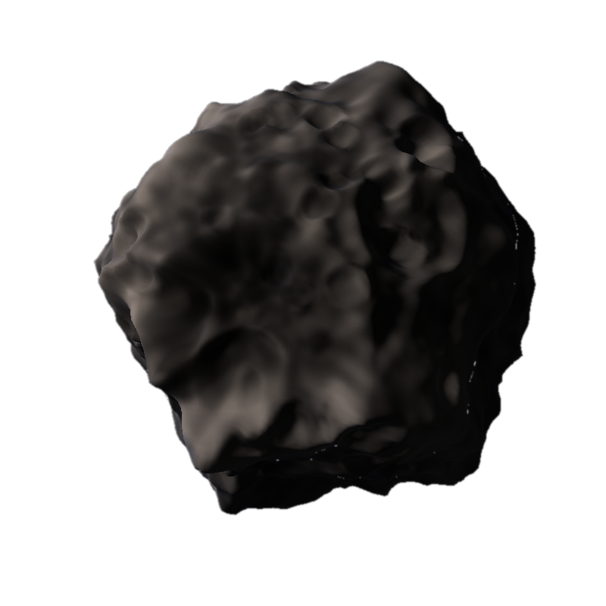
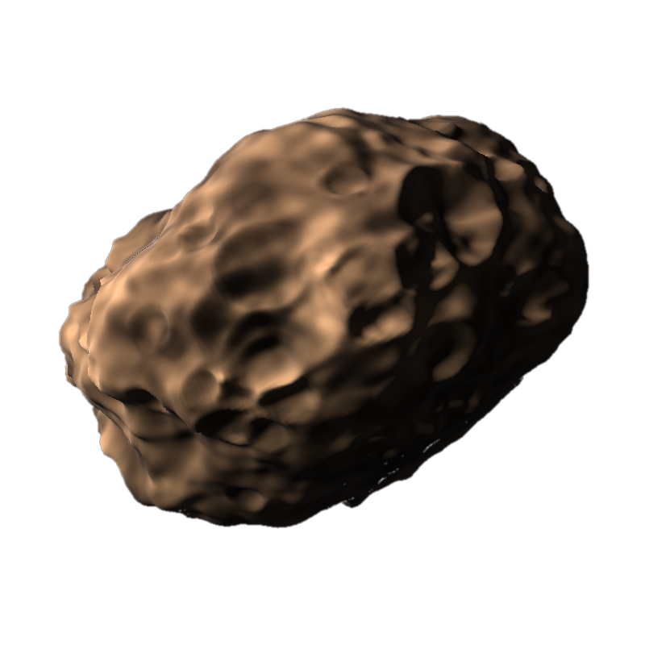
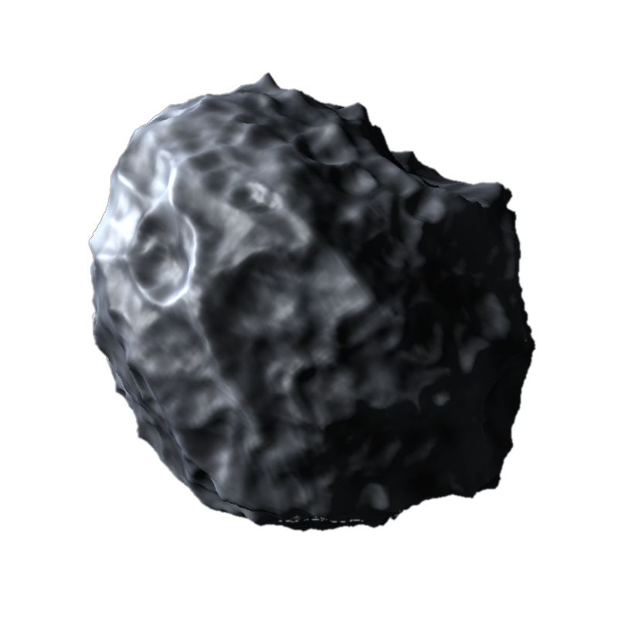
05 | Know your target: three asteroid types
Different compositions mean different mining plans. Artistic 3D renders of the main classes.
C-TYPE | CARBONACEOUS
S-TYPE | STONY
M-TYPE | METALLIC
Dark and primitive. May hold carbon compounds and water-bearing minerals.
Silicate rock mixed with some metal. Common in the inner belt.
Metal-rich, mostly iron and nickel. Rarer, and a candidate for structural metals.
Shapes and surface detail are illustrative. Real composition must be measured by survey.

Slide 7
06 | How mining can happen outside Earth
A staged mission avoids assuming that mining is already routine.
1 Detect
Telescope / survey spacecraft finds candidate objects.
2 Characterize
Measure orbit, shape, spin, and composition.
3 Rendezvous
Match the target's motion; approach slowly.
4 Anchor & sample
Secure the robot and collect a small test sample.
5 Extract & process
Separate useful material; capture dust and fragments.
6 Use in space
Store water, make oxygen/propellant if feasible, or use material in construction.

Slide 8
07 | AI model: perception → decision → action
Proposed onboard autonomy—not a trained or flight-certified AI system.
INPUTS
Camera • lidar
Spectra • IMU
Power / temperature
AI PERCEPTION
Detect asteroid edge
Estimate pose & spin
Flag hazards
PLANNER
Choose approach
Select anchor point
Limit drill force
ACTIONS
Thrusters • arm
Drill • sample bin
Safe-stop mode
Safety rule: AI recommends and monitors; hard limits and a safe-stop controller prevent unsafe drill force, collision risk, or uncontrolled release of material.

Slide 9
08 | What happens to the mined material?
The strongest business case is often using resources in space—not returning raw ore to Earth.
WATER
Capture and purify if present
OXYGEN
Possible life-support feedstock
PROPELLANT
Electrolysis / processing only if energy and infrastructure allow
CONSTRUCTION
Regolith / metals may support shielding or structures
Important: resource extraction, purification, storage, and transfer are major engineering challenges. This deck presents a proposed pathway, not a proven commercial service.

Slide 10
09 | Engineering risks and how to test the idea
Unknown composition
Map spectra; sample first; stop if target is unsuitable.
Microgravity dust
Enclosed tools, capture skirts, slow drilling, contamination controls.
Weak anchoring
Test harpoons / clamps on representative simulants; monitor loads.
Power & heat
Duty-cycle tools, store energy, reject heat, survive eclipse conditions.
Autonomy failures
Ground simulations, hardware-in-loop tests, redundant safe modes.
Economics
Compare cost per kg delivered in space with launch-only alternatives.

Slide 11
10 | The proposed solution
ASTRA: survey intelligently, mine cautiously, process locally, and use resources beyond Earth.
WHY THIS APPROACH?
• AI-assisted target selection and navigation
• Modular robotic miner
• Small sample before full extraction
• In-space use can reduce the need to launch every kilogram from Earth
NEXT STEP
Test the robot and extraction process in a simulated microgravity / vacuum environment.
Concept model only • dimensions and orbit layout are illustrative • no flight-ready performance is claimed

